Slide 2







Flood monitoring with satellite and SAR data
Review -1
Guide: Dr. Rajathilagam B
Group No:42
SL NO. | Name | Roll No
1 | Amit kumar | CB.EN.U4CSE22002
2 | Ankit Raj | CB.EN.U4CSE22105
3 | Mahavir Gautam | CB.EN.U4CSE22236
4 | Ayush kumar | CB.EN.U4CSE22506

Slide 3
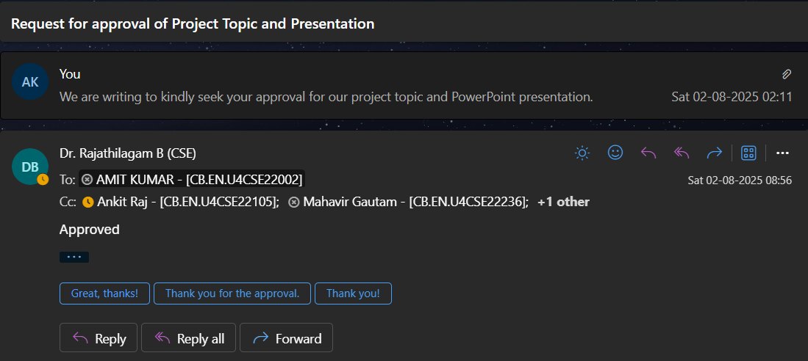
Guide’s Approval

Slide 4
Problem Statement
Floods in India affect over 75 million people annually, with major damage to life, property, and agriculture.
While satellite data and rainfall analysis exist, the systems are disjointed, post-event, and not interpretable by field workers or the public.
Our Proposal :
This project builds a real-time, explainable flood monitoring system, integrating:
Rainfall triggers (CHIRPS)
Satellite flood detection (Sentinel-1/2)
Historical impact validation (IFI)
LLM-generated alerts (Flan-T5)
Note : This is not just flood mapping; it’s smart decision-support for local governments.

Slide 5
Technical Feasibility
Component | Challenge | Our Solution
SAR (Sentinel-1) | Noisy (speckle) radar images | Use GEE + SNAP to apply speckle filtering
NDWI (Sentinel-2) | Blocked by clouds in monsoon season | Apply cloud masking and combine with SAR
CHIRPS Rainfall | Coarse resolution, raw data | Reproject and align in GEE for district analysis
IFI (Flood Inventory) | Non-spatial CSV format | Join with LGD codes to map to districts
LLM (Flan-T5/GPT) | Needs domain-aware prompts | Use structured examples and few-shot prompting

Slide 6
Literature Review & Research Gap
Past Work Summary :
SAR used in flood mapping in Bihar and Assam.
Sentinel-2 NDWI used for water body segmentation.
IFI (India Flood Inventory) provides historical flood data.
CHIRPS used globally for rainfall pattern analysis.
Research Gap :
No Indian project combines:
Real-time rainfall trigger.
SAR + NDWI fusion.
District-level historical flood validation.
LLM-generated human-readable alerts.

Slide 7
Literature Review & Research Gap
Literature Review Table :
Title | Year | Publisher | Work | Drawbacks
SAR Flood Detection in Bihar | 2023 | MDPI | Used Sentinel-1 SAR for single-event mapping | Post-event, no real-time alerts
Sen2FloodNet | 2022 | MDPI | SAR + NDWI fusion model | Not India-focused, no rainfall or LLM integration
IFI v3 | 2024 | arXiv | Multi-decade flood inventory of India | No satellite data or early warning
CHIRPS Rainfall | 2015 | UCSB | Daily global rainfall dataset | Needs integration with real-time alert system
Flan-T5 (Google LLM) | 2022 | arXiv | Instruction-tuned LLM | Not trained for climate/flood alerts

Slide 8
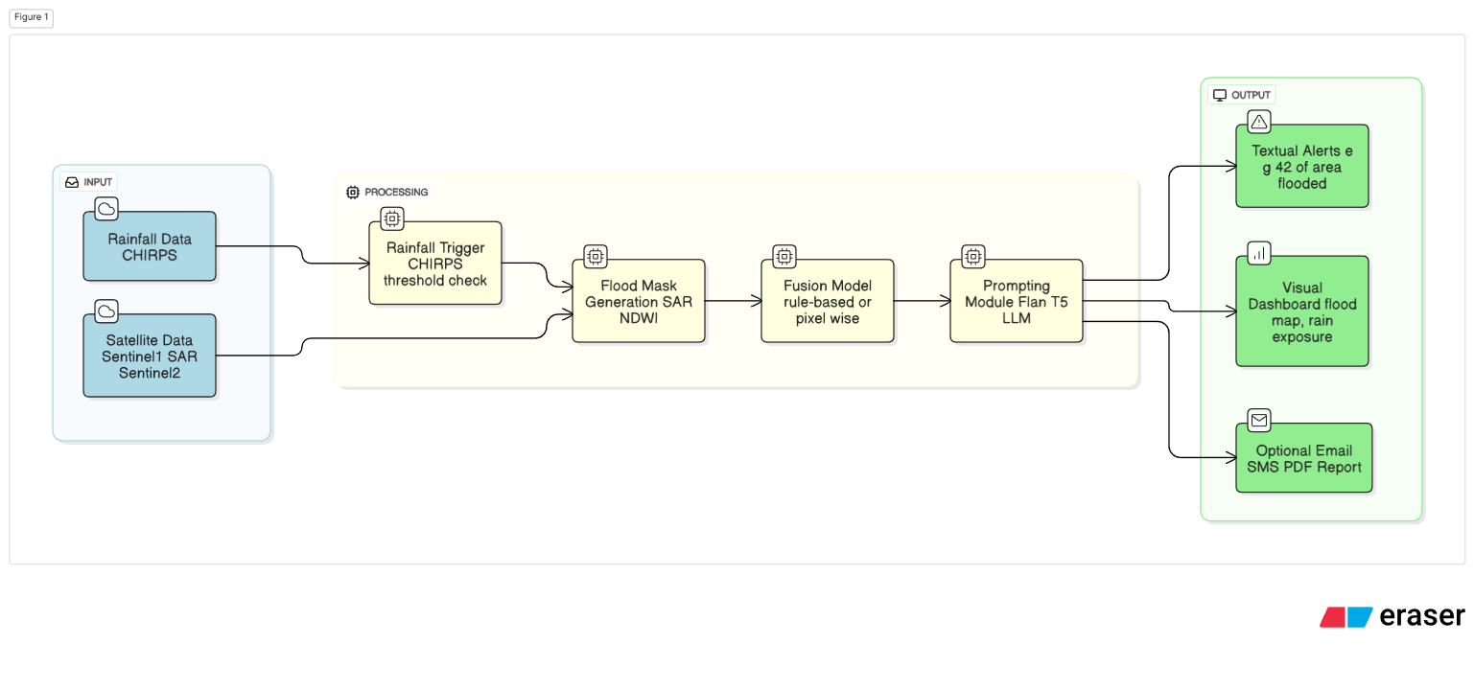
System Architecture Diagram

Slide 9
Role of LLM in Flood Monitoring
Why LLM?
Translates flood detection data into clear, human-readable alerts Automatically generates district-wise summaries.
Supports alerts in English and regional languages.
How It Works:
System detects flood area and exposed population.
Structured data sent to LLM.
LLM generates concise alerts like:“ Patna is 42% flooded; 15,200 people at risk.”
Benefits:
Easy to understand and share via mobile or PDF.
Fast, scalable, and reliable messaging.
Connects satellite insights to real-world response.

Slide 10
Dataset Summary
Dataset | Source | Purpose | Resolution
Sentinel-1 | ESA | SAR-based flood mapping | 3-5 m spatial
Sentinel-2 | ESA | NDWI water index | 5 m spatial
CHIRPS | UCSB / FEWS | Rainfall trigger | 5 km spatial, daily
IFI v3 | NIDM/IMD | Historical flood validation | District level
WorldPop | worldpop.org | Population at risk estimation | 100 m spatial

Slide 11
Execution Plan
Modules:
1. Rainfall Trigger
Uses CHIRPS data to activate pipeline only when rainfall crosses threshold.
2. Satellite Fusion
Merges Sentinel-1 SAR (cloud-proof) + Sentinel-2 NDWI for accurate flood maps.
3. Validation
Compares with IFI records (1967–2023); estimates affected population using WorldPop.
4. LLM Alerts
Generates readable flood summaries using Flan-T5/GPT (e.g., "15,000 people at risk").
5. Dashboard
Visualizes flood maps, alerts, and rainfall on an interactive interface.

Slide 12
Deliverables
Flood Mapping Pipeline:
Developed using Google Earth Engine (GEE) and Python, combining Sentinel-1 SAR and Sentinel-2 NDWI for flood detection.
Rainfall Trigger + IFI Matching:
Real-time rainfall monitoring using CHIRPS, activated only during high-risk events. Flood detections are validated using historical IFI v3 data.
LLM-Based Alert Generator:
Integrated Flan-T5 model generates concise, district-wise alerts describing flood severity and population impact.
Dashboard / Alert Reporting:
Visual interface to display flood maps, rainfall status, and generated alerts; supports export as PDF/CSV or integration with messaging platforms.
Final Documentation & Codebase:
Includes a detailed project report, GitHub repository with scripts, model configs, and instructions for reproducibility.

Slide 13
Evaluation Metrics
Metric | Module | Purpose
IoU | Satellite mask | Accuracy of flood mask (vs IFI truth)
Precision/Recall | Detection | Evaluation of flood vs non-flood
BLEU/ROUGE | LLM Output | NLP fluency and correctness
Time-to-Alert | Entire system | Speed of response after rainfall trigger

Slide 14
Team Responsibilities & Tasks
Module / Responsibility | Key Tasks
Satellite Imagery Processing (Sentinel-1 SAR + Sentinel-2 NDWI) | Collect SAR & optical data from GEE Preprocess SAR: filtering, calibration Generate NDWI with cloud masking Apply flood mapping thresholds Fuse SAR & NDWI for enhanced water detection
Rainfall Monitoring & Trigger System (CHIRPS dataset) | Analyze CHIRPS rainfall data Set adaptive rainfall thresholds Monitor real-time rainfall Trigger pipeline when threshold is breached
Historical Validation & Risk Estimation (IFI v3 + WorldPop) | Process India Flood Inventory (1967–2023) Map IFI to districts using LGD codes Match predictions to past flood patterns Estimate at-risk population with WorldPop
LLM Alert Generator & Reporting (Flan-T5 or GPT) | Format input prompts for LLM Generate flood alerts in English & regional languages Post-process for clarity Generate reports (PDF/Dashboard) Evaluate using BLEU/ROUGE metrics

Slide 15
References
Saharia, M., et al. (2021).India Flood Inventory. Natural Hazards. https://doi.org/10.1007/s11069-021-04698-6
Baishya, R. R., et al. (2024).A District-Level Flood Severity Index for India. arXiv Preprint. https://arxiv.org/abs/2405.01602
Sen2FloodNet (2022). Flood Mapping with Optical and SAR Data Fusion. MDPI Remote Sensing, 14(2), 428. https://www.mdpi.com/2072-4292/14/2/428
CHIRPS Dataset. University of California, Santa Barbara (UCSB). https://www.chc.ucsb.edu/data/chirps
Chung, H. W., et al. (2022).Flan-T5: Scaling Instruction-Finetuned Language Models. Google Research, arXiv. https://arxiv.org/abs/2210.11416

Slide 16


